Slide 1

SPECIAL PROJECT-I
Voice assistant For PC Management
BY
Tarun A(20STUCHH010130)
Pawan Kalyan(20STUCHH010020)

Slide 2
OBJECTIVE’S
Using Python to create a voice assistant script.
Input voice is used in this project to render speech output and display text on the screen. Our fundamental goal with voice assistance is to use a computer to make people smarter and get outcomes more quickly. Voice Help uses our microphone to record voice input and translates it into comprehensible computer language, providing the user with the answers and solutions they need. To deliver the results the user has requested, this service is connected to the World Wide Web. Computer systems can communicate in a variety of ways utilising natural human language thanks to the Natural Language Processing algorithm.

Slide 3
SOFTWARE’S USED
Python
Qt Designer, you may quickly and effectively develop GUIs for your PyQt applications. By dragging and dropping QWidget items onto an empty form, you can use this tool to create GUIs.

Slide 4
ADVANTAGES
Little effort,saying a few words is simpler than typing them .
Ears and voice is enough to get help from voice assistant
Easy to use.
Fast response
Minimally Disruptive.
Speaks multiple languages

Slide 5
DISADVANTAGES
Costly.
Make common grammatical Errors.
Makes commnication Less personal.
Privacy concerns

Slide 6
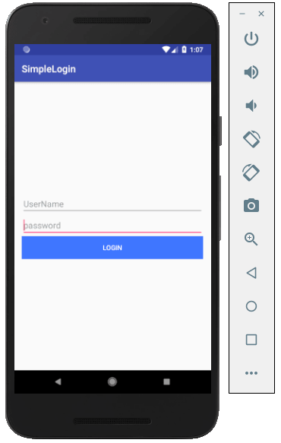
HOW DOES THE Voice Assistant WORK
Users can command voice assistants by saying hey or name given to assistant followed by the command word they want it to follow. For example, if a user says Hey Google, followed by the command to play songs. Google will be activated and play all of songs in your library or from the webbrowser.
The Top 3 Voice Assistants in present life
1) Google assistant
2) Apple siri
3) Amazon alexa
ant some are cortana for windows and samsung use bixby

Slide 7
THANKS

